Slide 1

Website
Walkthrough...

Slide 2
Overview
About Company
Programs
Certificate in Data Science Foundation
Global Certificate in Data Science
Global Certification in Data Science and AI
My Classroom
Resources
Community
Free 1-on-1 Career Consultation
GCD Reviews
Insights
About

Slide 3

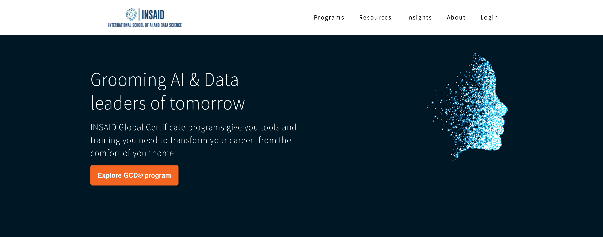
Website Link: https://www.insaid.co

Slide 4
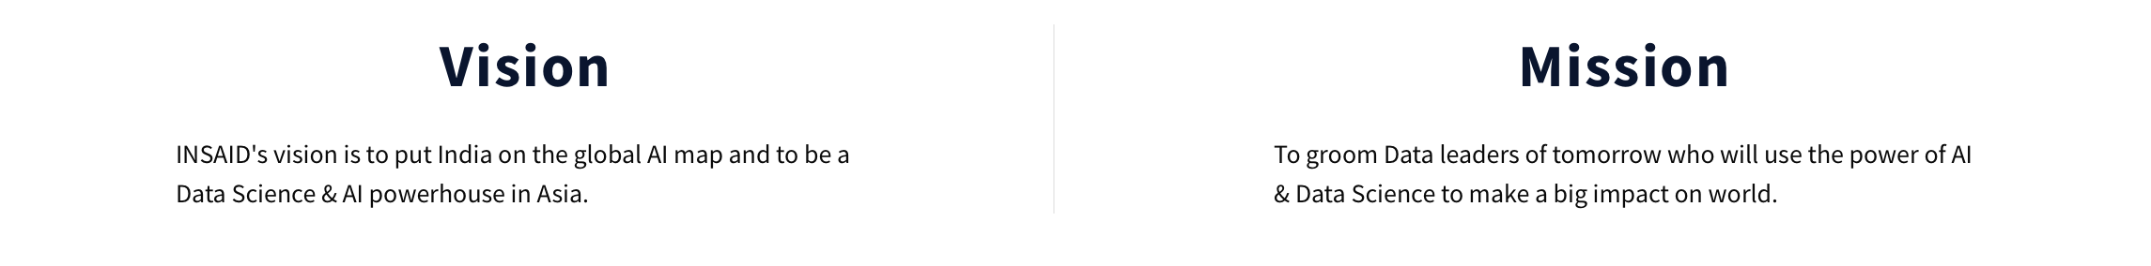
About Company
Link: https://www.insaid.co/about/
INSAID stands for International School of AI and Data Science.
INSAID is India's first academic institution dedicated to research and education in Data Science & A.I. established in 2018.
Our Global Certificate programs gives you tools and training you need to transform your career from the comfort of your home.

Slide 5
INSAID’s Ecosystem
Website
E-mail
Programs
My
Classroom
Resources
Insights
About
Academics
Queries
Info
Admissions
GCD
Program
Data
Science
Foundation
GCD
Reviews
1 – on – 1
Career
Consultation
Blog
Vision

Slide 6
Emails
Name Academics Queries Information Admissions | Id academics@insaid.co queries@insaid.co info@insaid.co admissions@insaid.co | Purpose To inform students about programs Status.(quizes, projects and queries) Through this we solve the queries . Through this we provide the account related information. (eg; password change) Through this we keep record of our students programs.

Slide 7
Overview
About Company
Programs
Certificate in Data Science Foundation
Global Certificate in Data Science
Global Certification in Data Science and AI
My Classroom
Resources
Community
Free 1-on-1 Career Consultation
GCD Reviews
Insights
About

Slide 8
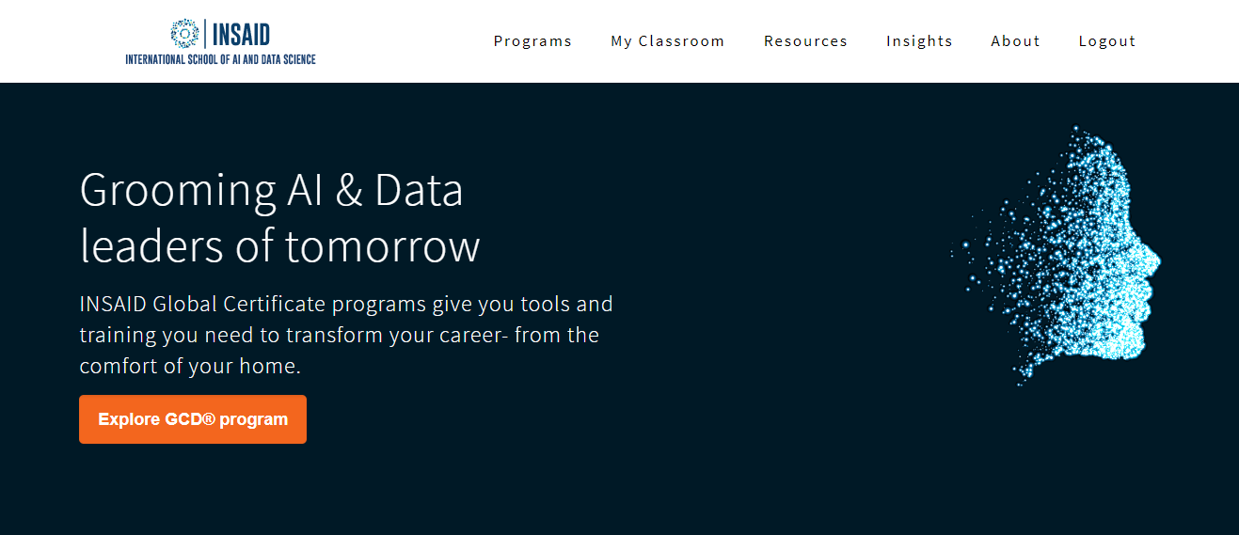
Programs
Link: https://www.insaid.co/
Our goal through the program is to equip you with concepts, context and exposure so that not only you have the tools and training but the exposure you require to become a Data leader of tomorrow.

Slide 9
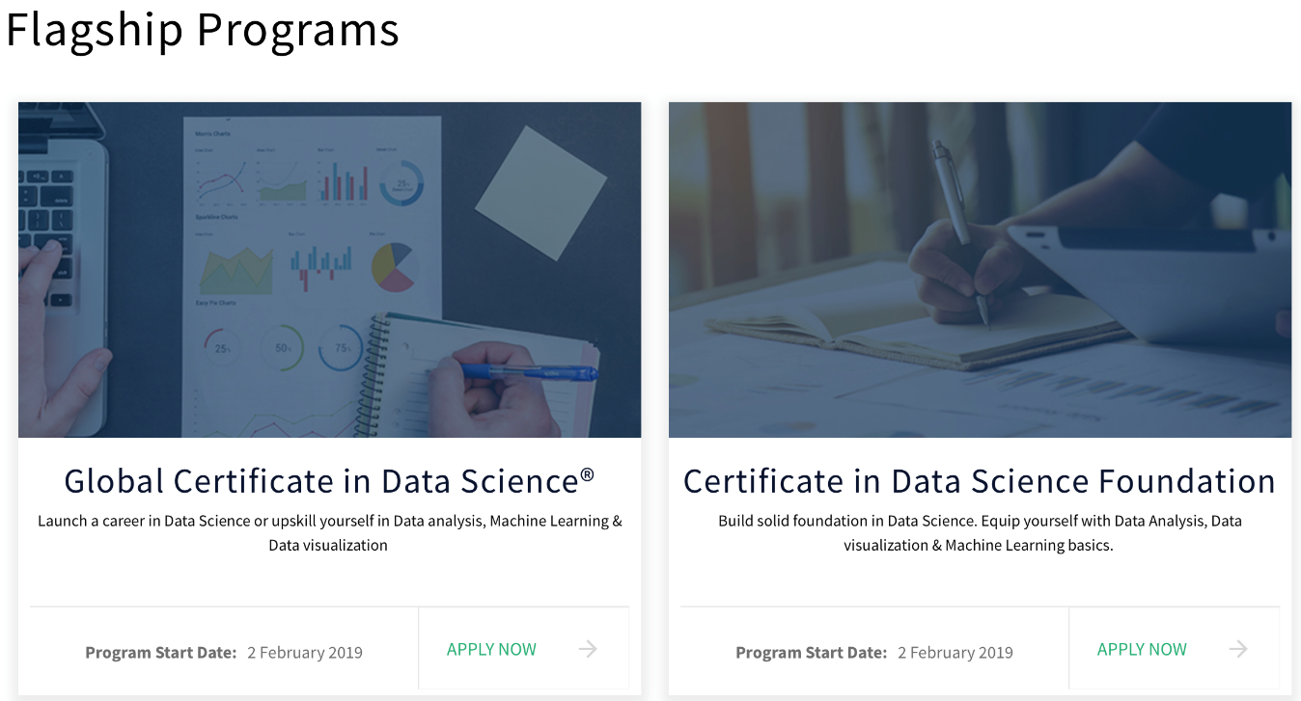
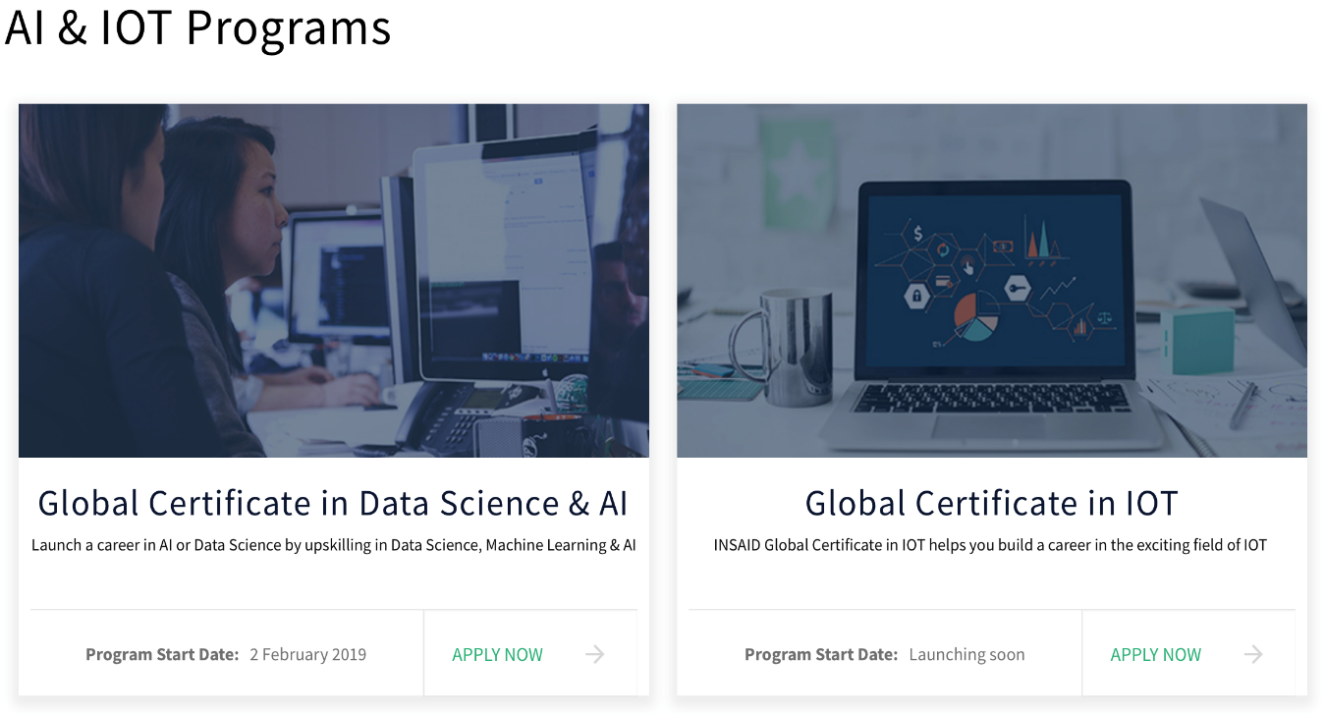
We help our students launch a career in the field of Data Science, Machine Learning, A.I. and other exciting field of IOT.
We provide certificates on completion of the courses.

Slide 10
Overview
About Company
Programs
Certificate in Data Science Foundation
Global Certificate in Data Science
Global Certification in Data Science and AI
My Classroom
Resources
Community
Free 1-on-1 Career Consultation
GCD Reviews
Insights
About

Slide 11
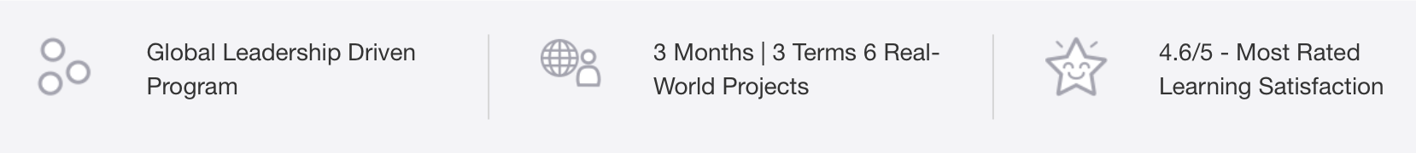
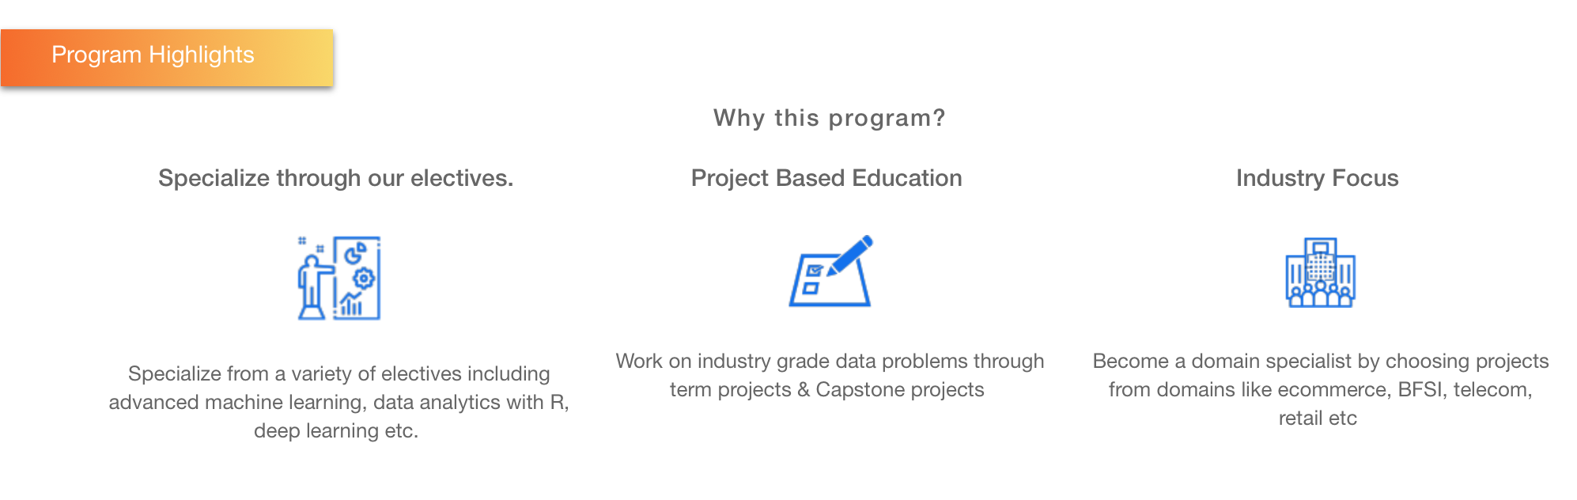
Certificate in Data Science Foundation
Link: https://www.insaid.co/global-certificate-in-data-science/

Slide 12
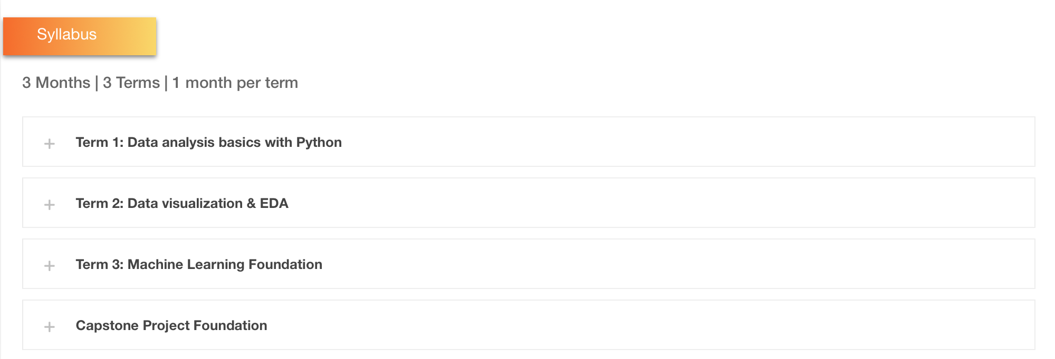

Slide 13
Overview
About Company
Programs
Certificate in Data Science Foundation
Global Certificate in Data Science
Global Certification in Data Science and AI
My Classroom
Resources
Community
Free 1-on-1 Career Consultation
GCD Reviews
Insights
About

Slide 14
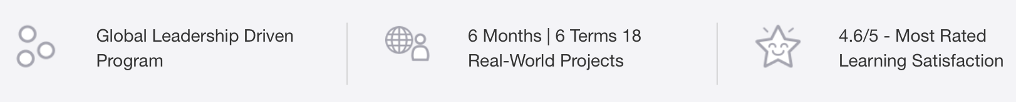
Global Certificate in Data Science
Link: https://www.insaid.co/certificate-in-data-science-foundation/

Slide 15
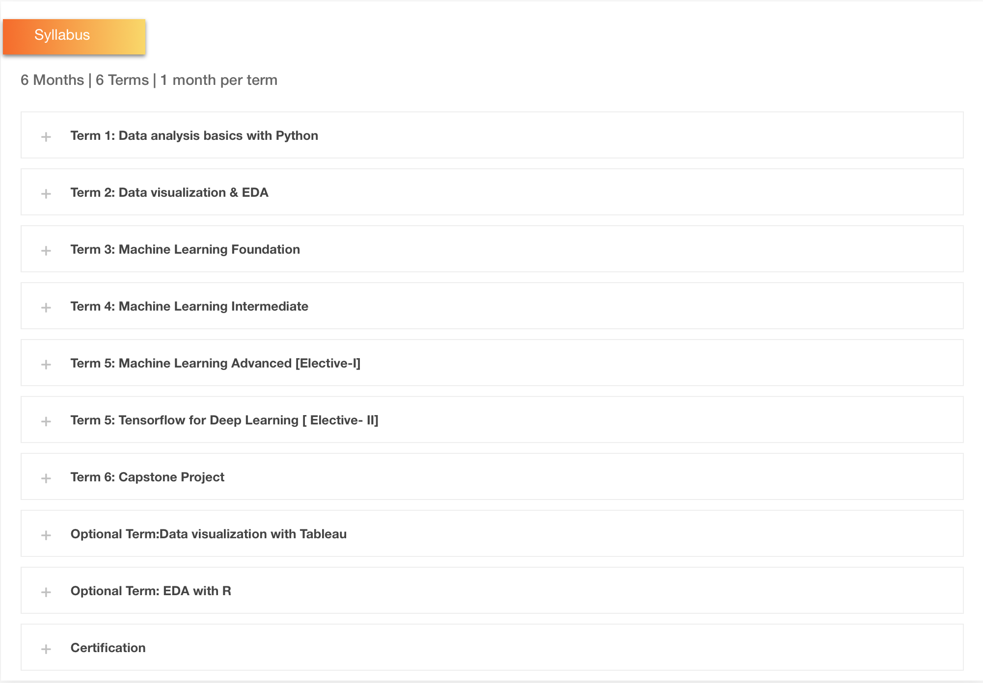

Slide 16
Overview
About Company
Programs
Certificate in Data Science Foundation
Global Certificate in Data Science
Global Certification in Data Science and AI
My Classroom
Resources
Community
Free 1-on-1 Career Consultation
GCD Reviews
Insights
About

Slide 17
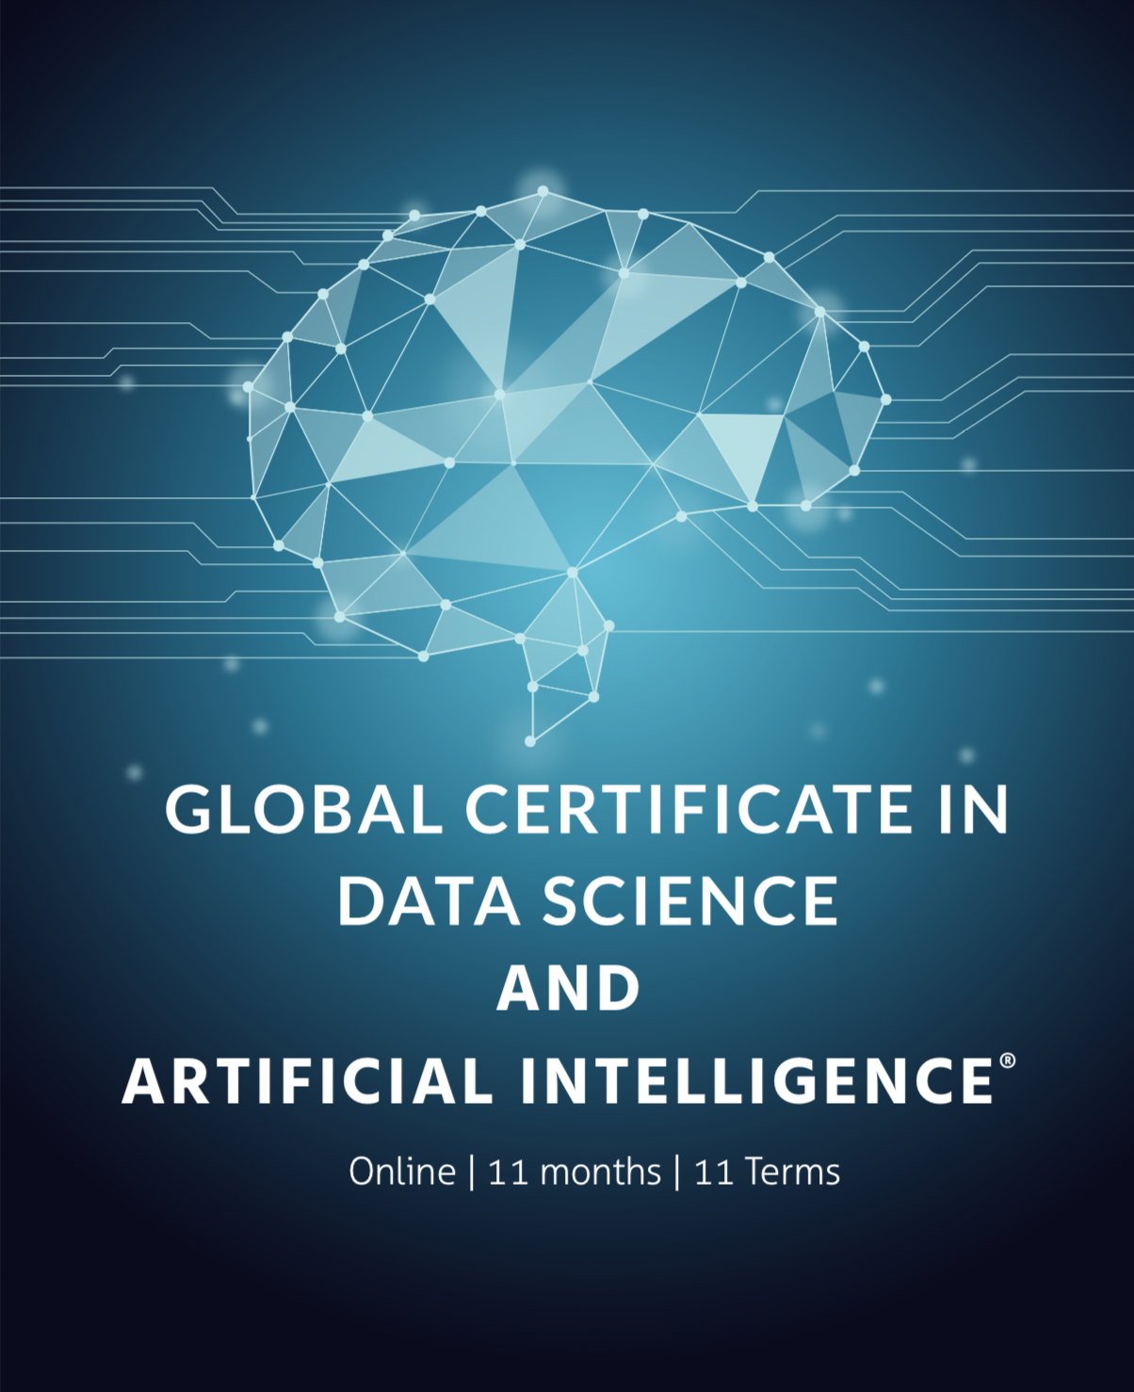
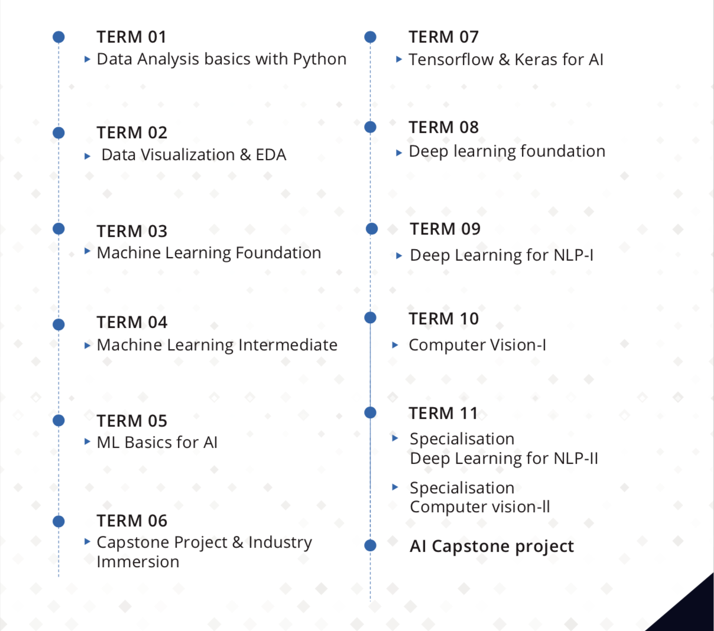
Global Certificate in Data Science and AI

Slide 18
Overview
About Company
Programs
Certificate in Data Science Foundation
Global Certificate in Data Science
Global Certification in Data Science and AI
My Classroom
Resources
Community
Free 1-on-1 Career Consultation
GCD Reviews
Insights
About

Slide 19
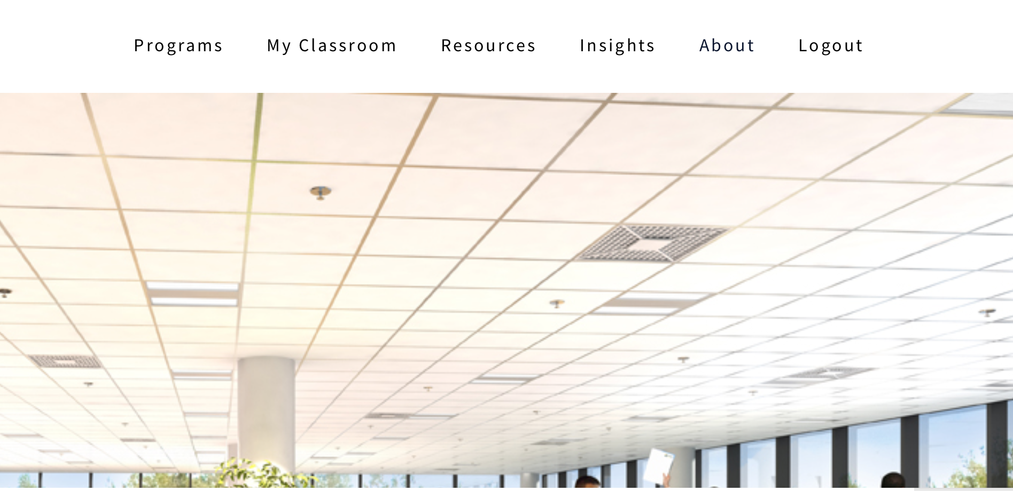
My Classroom
https://programs.insaid.co/enrollments

Slide 20
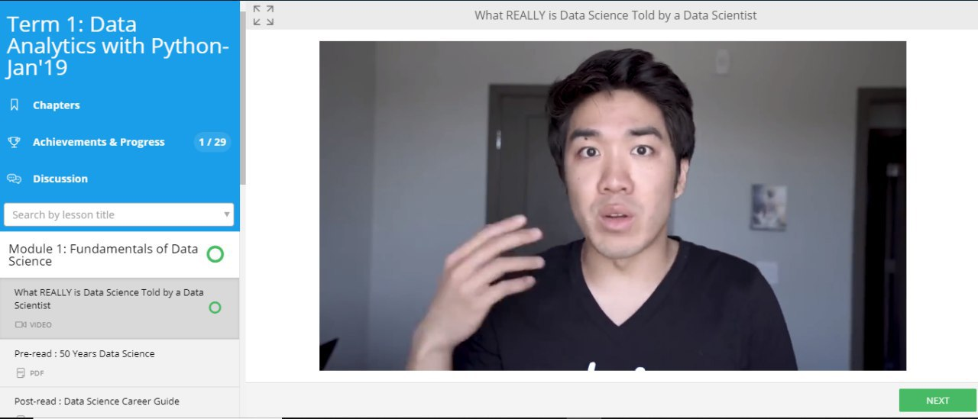
We provide Pre-reads that are read prior to the lectures so that it can help in succumbing the concepts clearly.

Slide 21
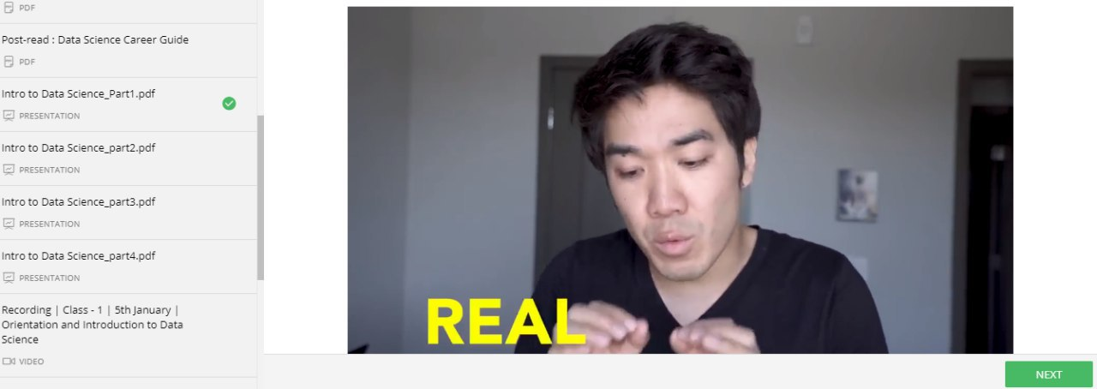
We provide Post-reads after the lecture to get detailed information about the particular topic

Slide 22
This is our course material

Slide 23
In case our students miss any lecture, they can always refer to our recordings. We have recordings available for all the lectures.

Slide 24
Overview
About Company
Programs
Certificate in Data Science Foundation
Global Certificate in Data Science
Global Certification in Data Science and AI
My Classroom
Resources
Community
Free 1-on-1 Career Consultation
GCD Reviews
Insights
About

Slide 25
Resources https://www.insaid.co/?page_id=33

Slide 26
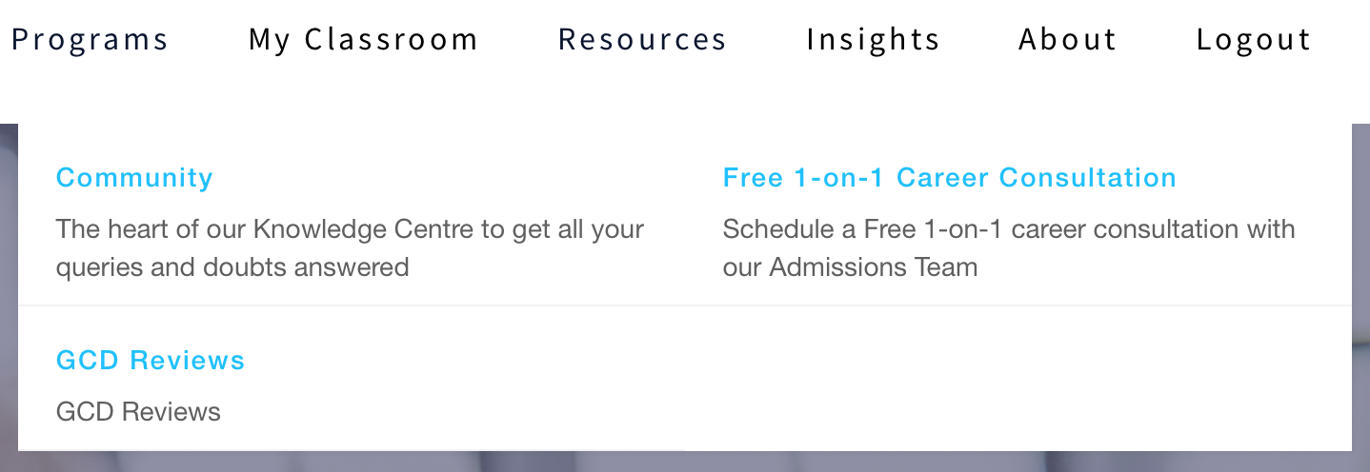
Resources include:
Community- The heart of our knowledge centre to get all your queries and doubts answered.
Free1-on-1 Career Consultation- Students can schedule a free1-on-1
Career Consultation with our admission team.
GCD Reviews- It includes some of the reviews from our current students.

Slide 27
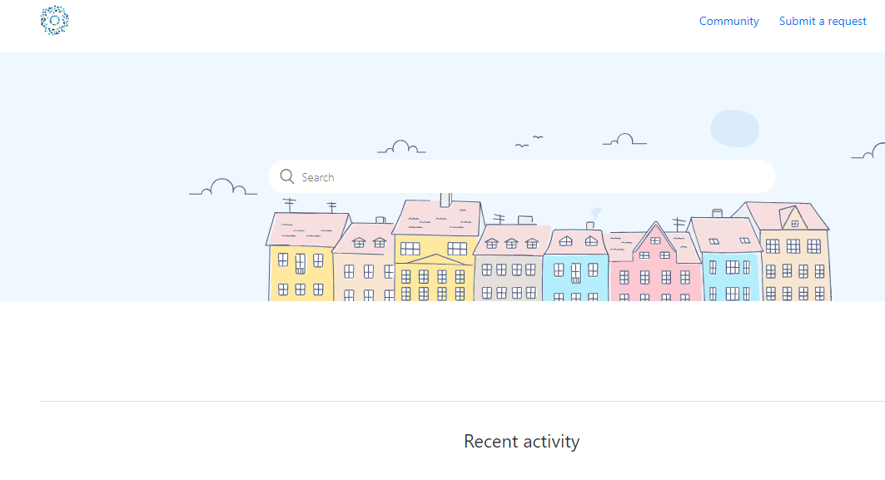
Community
Link: https://www.community.insaid.co

Slide 28
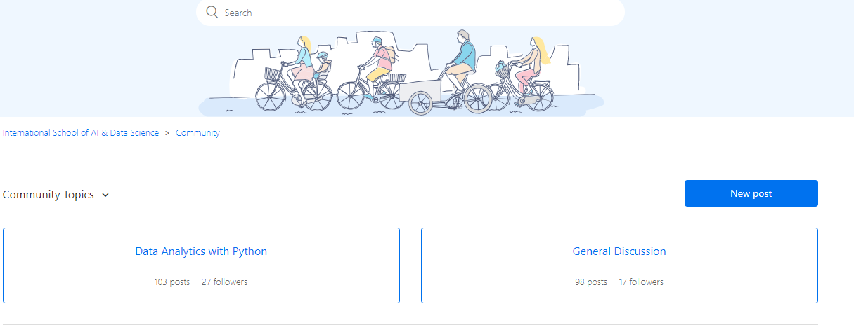
Community Topics

Slide 29

Submit a Request

Slide 30
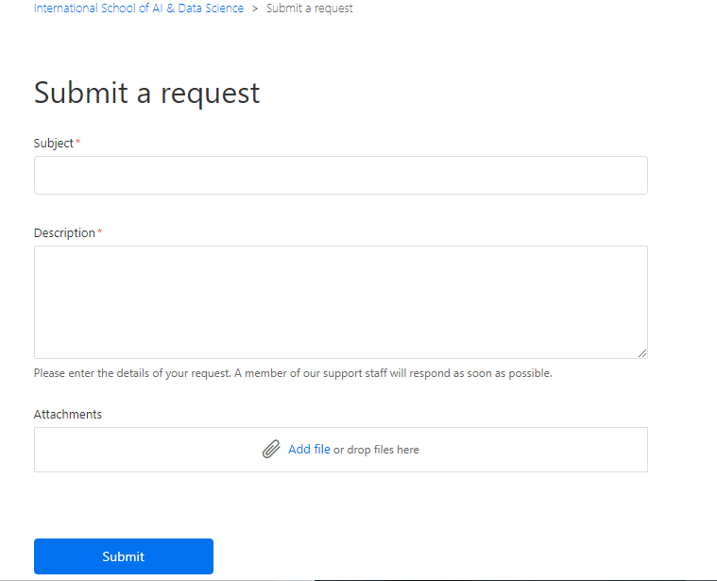

Slide 31
Overview
About Company
Programs
Certificate in Data Science Foundation
Global Certificate in Data Science
Global Certification in Data Science and AI
My Classroom
Resources
Community
Free 1-on-1 Career Consultation
GCD Reviews
Insights
About

Slide 32
Resources: Free 1-on-1 Career Consultation
Link: https://www.insaid.co/talk-to-admissions/
Free 1-on-1 career consultation with our admission team helps our Students to have a clear vision of their path to becoming a successful Data Scientist.
They can solve their day to day queries regarding our lectures and course materials

Slide 33
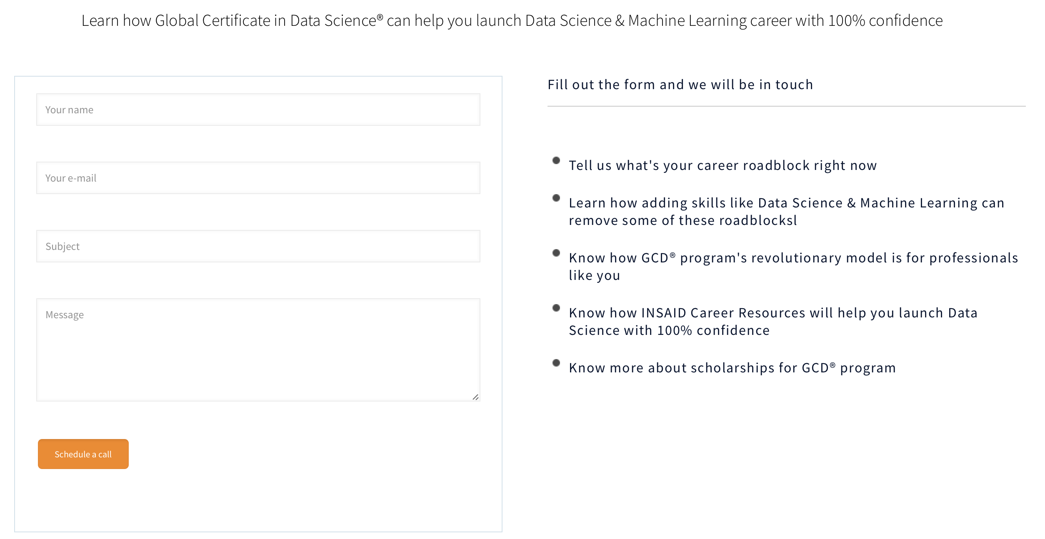
Talk to Admissions Team

Slide 34
Overview
About Company
Programs
Certificate in Data Science Foundation
Global Certificate in Data Science
Global Certification in Data Science and AI
My Classroom
Resources
Community
Free 1-on-1 Career Consultation
GCD Reviews
Insights
About

Slide 35
Resources: GCD Reviews
Link: https://blog.insaid.co/reviews-what-our-students-say-about-their-gcd-experience/
GCD Reviews provides us the feedbacks of our programs from our students. This helps us improve and make our programs more resourceful to our students.

Slide 36
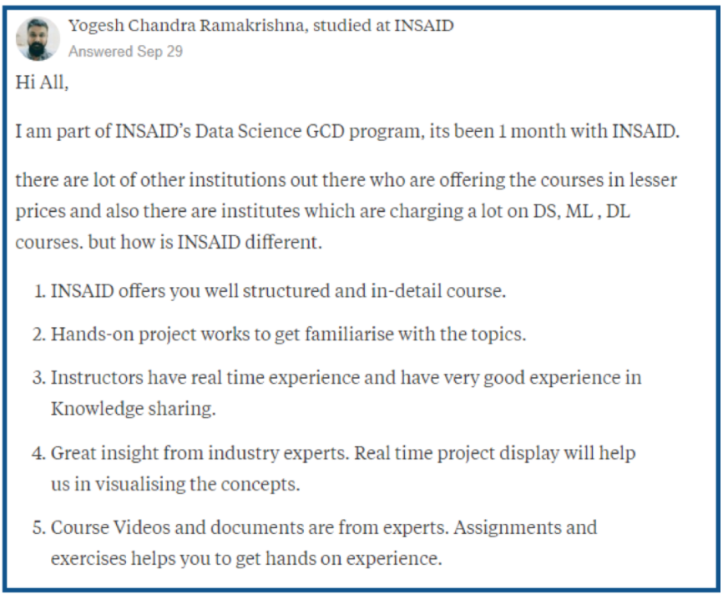
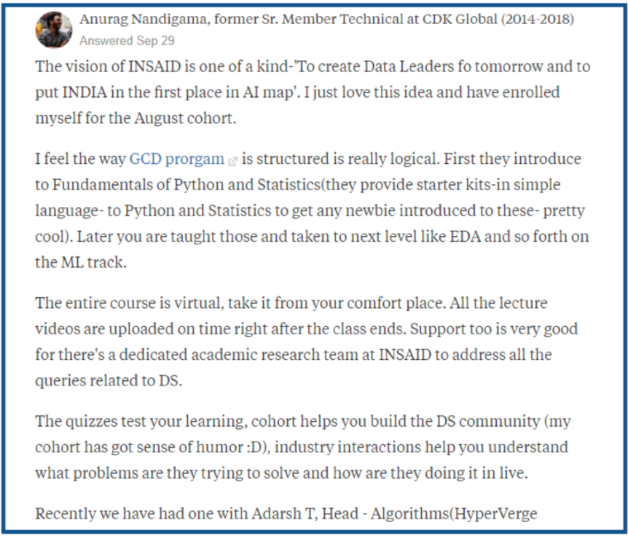
Reviews

Slide 37
Overview
About Company
Programs
Certificate in Data Science Foundation
Global Certificate in Data Science
Global Certification in Data Science and AI
My Classroom
Resources
Community
Free 1-on-1 Career Consultation
GCD Reviews
Insights
About

Slide 38

Insights
http://blog.insaid.co
INSAID’s Insights include blogs, tutorials, beginner’s series, career articles and many more subfields.

Slide 39
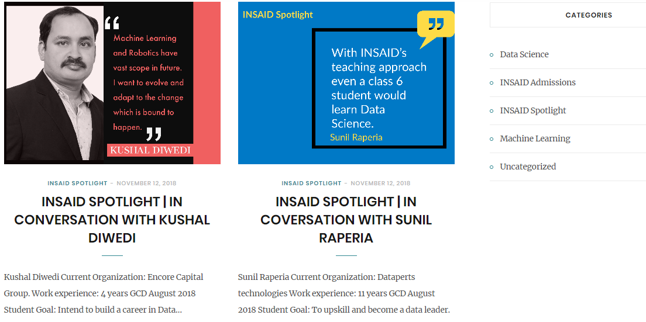
INSAID’s spotlight help our students to share their goals of becoming a Data Scientist, as our students are from different backgrounds from college students to employers in various companies.

Slide 40
Overview
About Company
Programs
Certificate in Data Science Foundation
Global Certificate in Data Science
Global Certification in Data Science and AI
My Classroom
Resources
Community
Free 1-on-1 Career Consultation
GCD Reviews
Insights
About

Slide 41

About
https://www.insaid.co/about/

Slide 42
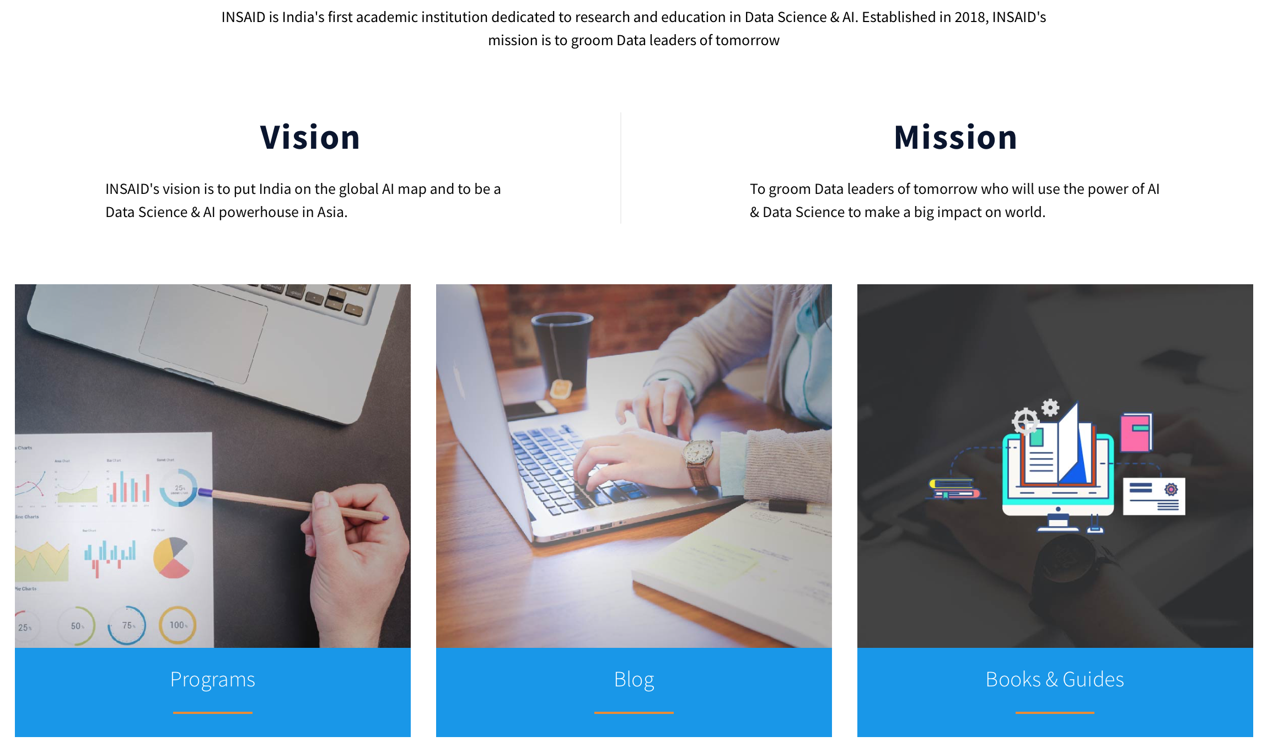

Slide 43

INSAID’S Career Centre
https://www.insaid.co/contact/
INSAID Career Centre helps you chart your career trajectory and get your dream job by:
Getting in-depth advice on salaries, roles & job trends though monthly career Q&A.
Attend industry immersion workshops to solve real industry problems.
Interacting with global leaders in Data Science, ML and AI.
Get up to INR 20 Lakhs in funding to launch your next AI/ML startup.

Slide 44
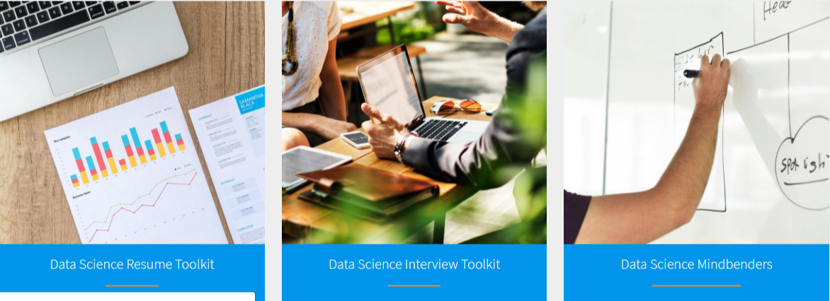
INSAID’s Catapult
https://www.insaid.co/global-certificate-in-data-science/#ILC
Start from basics and move to advanced topics with ease.
Faculty from world's premier institution like ISB.
Launch successful Data career with INSAID Career Centre.
Launch your own ML startup with 15 cr INSAID Vision Fund®.

Slide 45
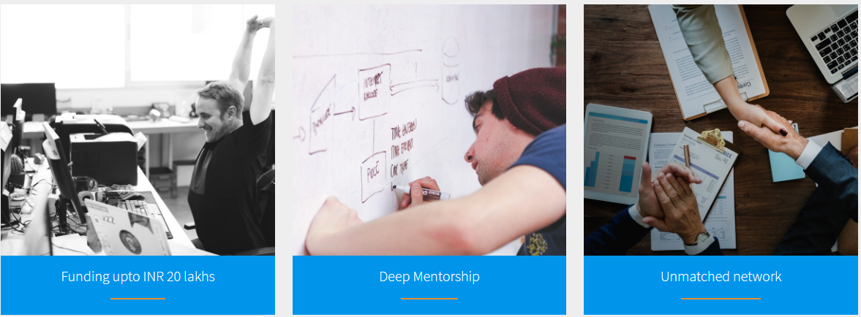
INSAID’s Vision Fund
https://www.insaid.co/global-certificate-in-data-science/#ILC
Many of us dream of becoming entrepreneurs and have a startup of our own. You an launch your own ML startup with INR 15 Cr. INSAID Vision Fund.

